Slide 1
Climate Change Analysis
CISC 520-90 Late Fall Department of Analytics Harrisburg University
Anil Kumar P
Vinaya Rajappa
Avneesh Sharma

Slide 2
Agenda:
Purpose
Introduction
History of Data
Techniques used for Analysis
Data Preparation
Exploratory Analysis
Hypothesis Testing
Correlation
Forecasting
Clustering
Conclusion
Risks, Scope and Assumptions
Tools

Slide 3
Purpose:
Global Warming: There is a perception which states that a gradual increase of Earth’s land and ocean average temperatures are the causes for permanently change in the Earth’s climate.
As a team, we would like to perform a hypothesis test to understand the existence of global warming.
How temperatures are raising in major cities across the world?
How USA temperatures are correlated with global temperatures?
How likely would be the next 10 years USA temperatures?
Based on global average temperatures, how the countries are clustered into different segments.

Slide 4
Introduction: History of Data
This global temperature data set has been downloaded from the kaggle data sets (direct link: https://www.kaggle.com/berkeleyearth/climate-change-earth-surface-temperature-data). The global temperatures data is available in the form “.csv” files. This is a time series data and monthly average temperatures are available in the downloaded files. In these files, temperatures are classified into several categories i.e. global land and ocean, by country, by city, by state, by major cities, etc. For few categories, data is available from the year 1750 and for few other categories data is available from the year 1850. For few countries data is not available.

Slide 5
Introduction: Analysis Techniques
As a part of this analysis, we had applied several data mining process techniques which we gained knowledge through the course during this semester. Analysis has been categorized into several tasks i.e. Data Preparation, Exploratory Analysis, Hypothesis testing, Correlation, Forecasting, Clustering, etc.

Slide 6
Data Preparation:
As a part of preparation, below tasks have been performed.
Importing data into R.
Converting variable data types into required data types.
Checking for missing values and handling them.
Identifying outliers.
Creating new data sets with required data for analysis.
Code Snippet:
sapply(unique(global_temp_country_1900), function(x)any(is.na(x)))

Slide 7
Data Preparation:
global_climate_1900 %>%
group_by(Year) %>%
summarise(AvgGlblTemp = mean(LandAverageTemperature)) -> global_climate_1900_avg
global_temp_country_1900 %>%
group_by(Country) %>%
summarise(AvgCountryTemp = mean(AverageTemperature)) -> global_temp_country_1900_avg
summary(global_climate_1900_avg)

Slide 8
Exploratory Analysis:
Once cleansed data is available, exploratory analysis has been performed.
As a part of this analysis, below tasks have been performed.
Computed basic statistics of the data.
Plotted histograms to understand the underlying distributions.
Plotted several time series plots to understand the trends of historic temperatures.
Plotted layer plots to compare different temperatures.
Hypothesis test is conducted to check the existence of global warming.

Slide 9
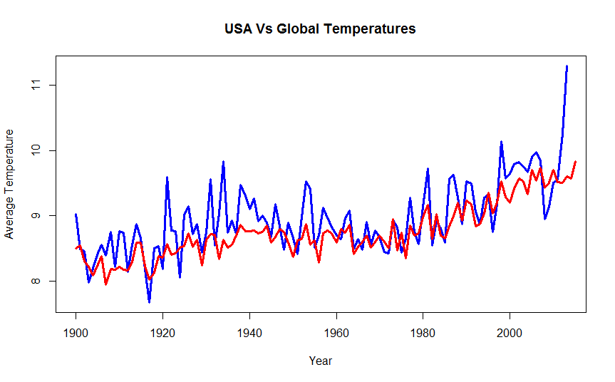
Exploratory Analysis:
‘USA Vs Global Temperatures’ graph represents Global temperatures and USA temperatures.
Always the USA temperatures are bit higher or equal to the global temperatures till the year 1980.
In recent years, the average temperature is rising drastically in the USA when compared with global average temperatures.

Slide 10
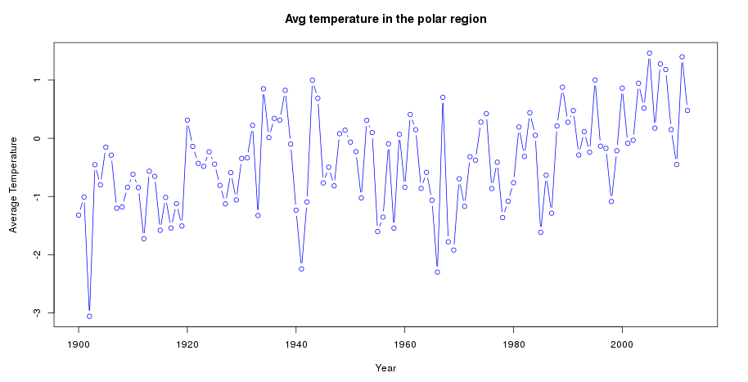
Hypothesis Testing:
To check the hypothesis statement as mentioned in the initial slides, we have performed analysis on polar and equatorial regions; and we tried relating the same with recent incidents.
We can see from the figure that the mean temperature of the polar region is steadily increasing. The alarming fact is that the average temperature is slightly above freezing point. This correlates to the recent incident of the largest iceberg poised to break away from the North Antarctic. This would cause the global sea level to rise by 10 cms which can submerge small island nations.

Slide 11
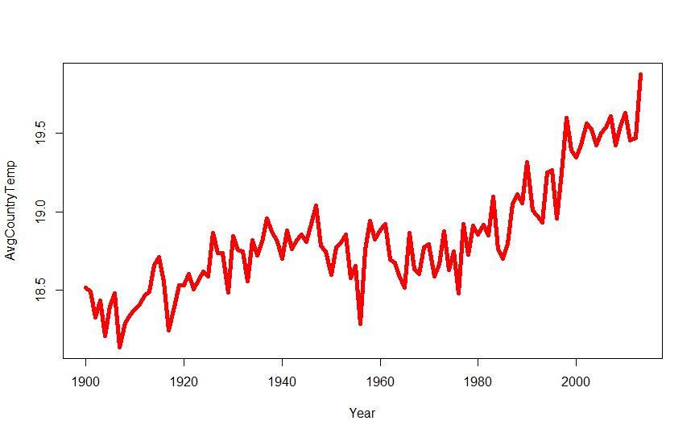
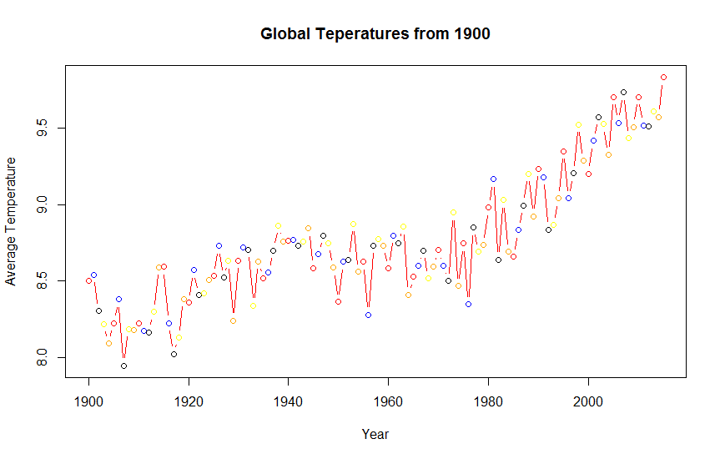
Exploratory Analysis:
The two graphs represent the ‘Average Country wise temperatures’ from the year 1990 to the year 2012 and ‘Average Global temperatures’ from the year 1900 to the year 2012.
Though both graphs have similar patterns, there is significant change in the average temperatures which can be observed on y-axis of each graph.
Histograms are useful to understand the underlying distributions of the data.

Slide 12
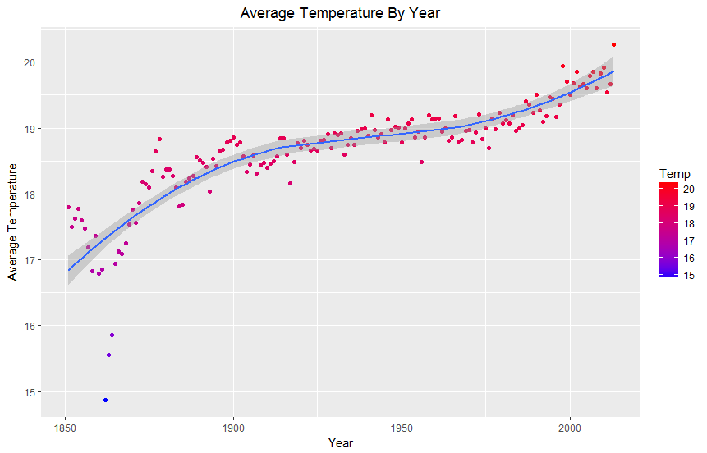
Exploratory Analysis:
This graph depicts the average temperatures recorded from the year 1850 to 2013 for all the 100 major cities across the world. We can observe an upward trend in temperature.

Slide 13
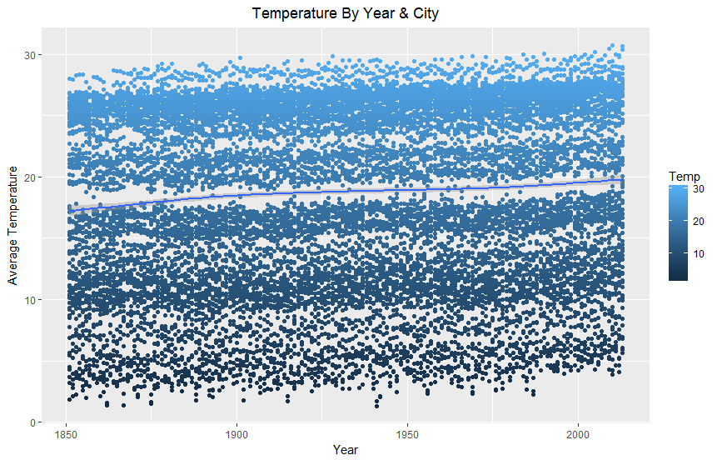
Exploratory Analysis:
The purpose of this graph is to visualize the average temperatures for all the cities across the years. The straight line is plotted to understand the general overall trend.

Slide 14
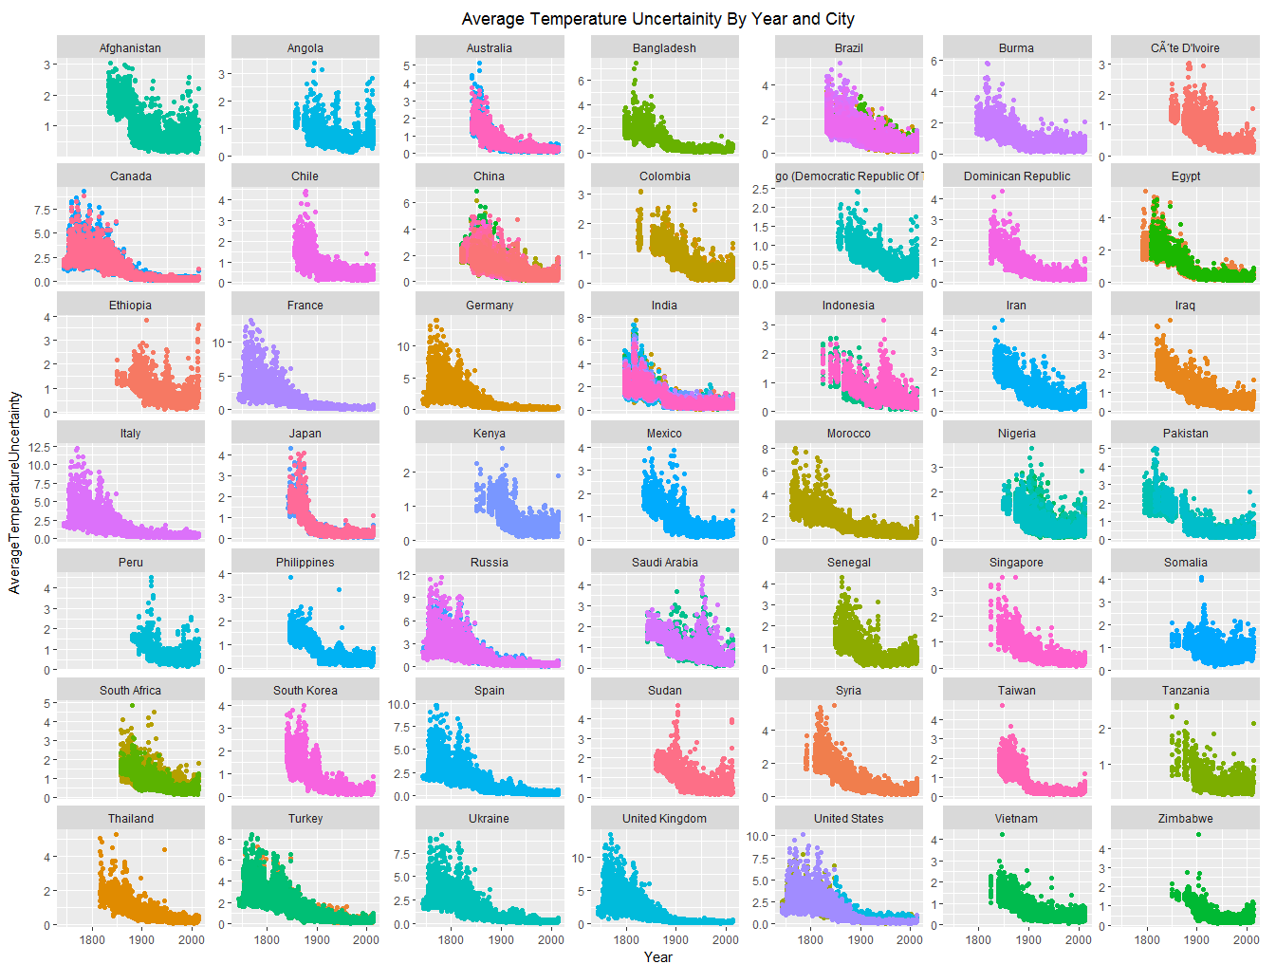
Exploratory Analysis:
The purpose of this chart was to get an understanding of how much of a factor Temperature Uncertainty variable is in the temperature recorded throughout the years. As the graphs show, as the years and the technology has progressed, the uncertainty has gone down with what can be assumed to be better recording instruments.

Slide 15
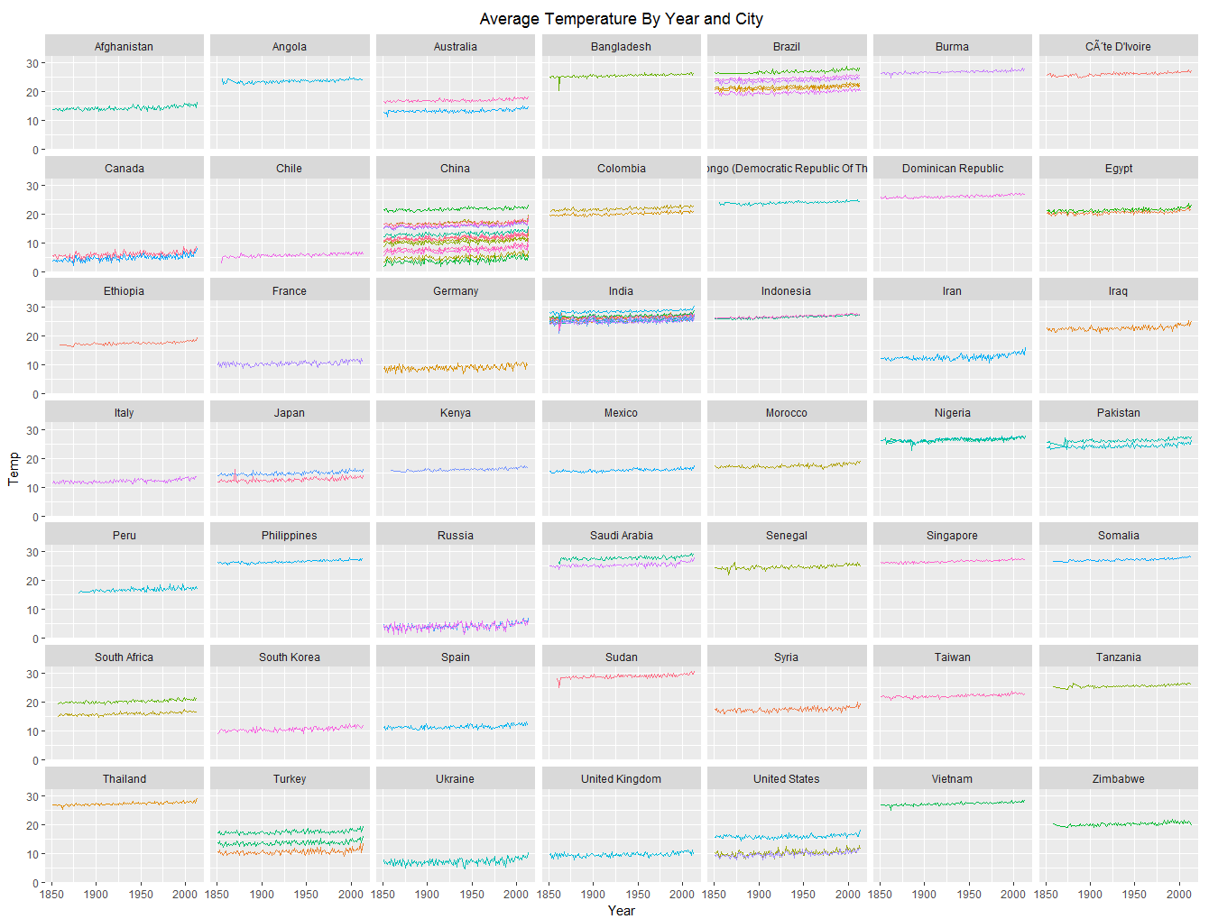
Exploratory Analysis:
This chart explains the Average Temperature by Year color coded by City. The chart is divided into facets of Countries. Each block is a country and each line is a city. We can observe individual city average temperature trends while comparing it against each other.

Slide 16
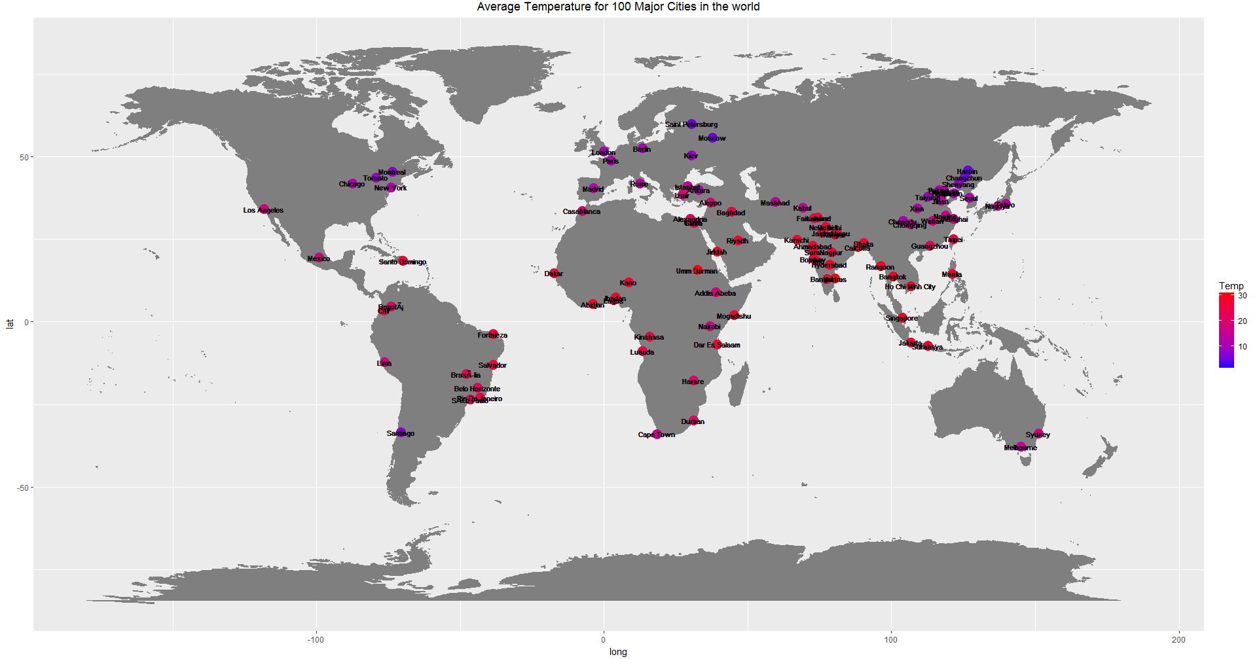
Exploratory Analysis:
Average Temperature for all the 100 cities from 1850 – 2013.

Slide 17
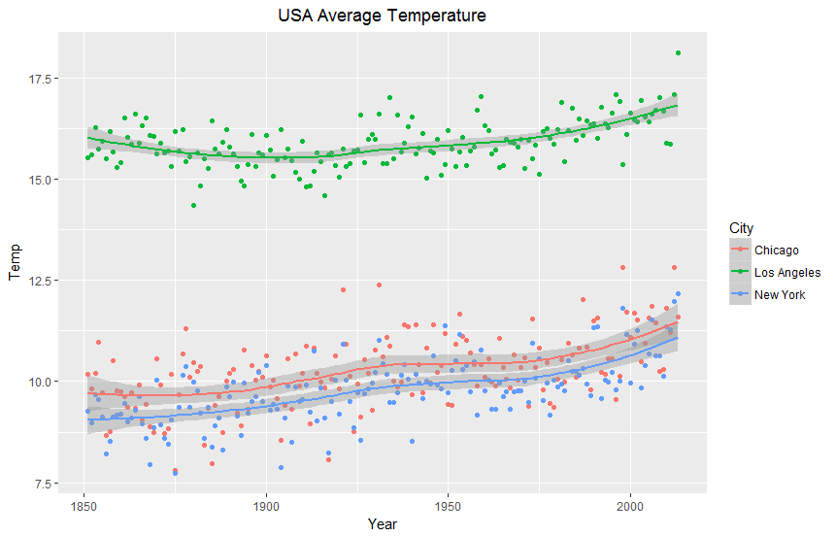
Exploratory Analysis:
This chart helps us study the Average Temperature trends for the 3 USA cities in the dataset. As we look at the data at such a granular level, we see a heightened variability in the temperatures recorded.

Slide 18
Exploratory Analysis:
Code Snippet:
plot(global_temp_country_1900_USA$Year, global_temp_country_1900_USA$AvgUsaTemp, type = 'l', col = "blue", lwd = 3, main = "USA Vs Global Temperatures", xlab = "Year", ylab = "Average Temperature")
lines(global_climate_1900_avg$Year, global_climate_1900_avg$AvgGlblTemp, col = "red", lwd = 3)
ggplot(data = global_temp_country_1900_avg_trimmed, mapping = aes(x = global_temp_country_1900_avg_trimmed$Country, y = global_temp_country_1900_avg_trimmed$AvgCountryTemp)) +
geom_bar(position = "dodge", stat = "identity") +
coord_flip() +
ggtitle("Highest Average Temperature - country wise") +
labs(x = "Countries", y = "Average Temperature")

Slide 19
Correlation:
The correlation between the USA and global temperatures is 0.79 as per ‘Pearson correlation’.
Code Snippet:
cor(global_temp_country_1900_USA$AvgUsaTemp, global_climate_1900_avg$AvgGlblTemp, method = 'pearson')
cor(global_temp_country_1900_USA$AvgUsaTemp, global_climate_1900_avg$AvgGlblTemp, method = 'spearman')
cor(global_temp_country_1900_USA$AvgUsaTemp, global_climate_1900_avg$AvgGlblTemp, method = 'kendall')

Slide 20
Forecasting:
Forecasting is one of the major method used for predicting future values of time series data based on historic values and present values.
For parametric time series data, we have several methods in forecasting i.e. moving average, ARIMA, trend models, random walks, Seasonal exponential smoothing, etc.
For this analysis, we have used ARIMA with moving average value of 15.
Before applying for any of the methods which is mentioned above, seasonality should be checked.
If there is a seasonality, the seasonality should be included while forecasting the future values.

Slide 21
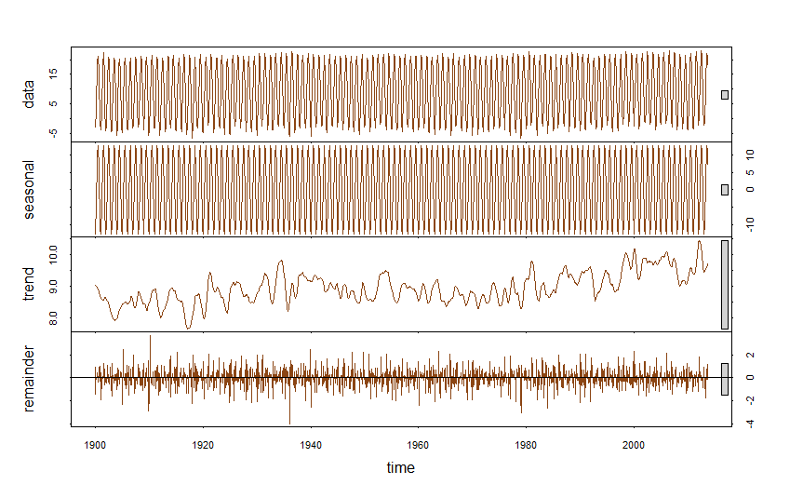
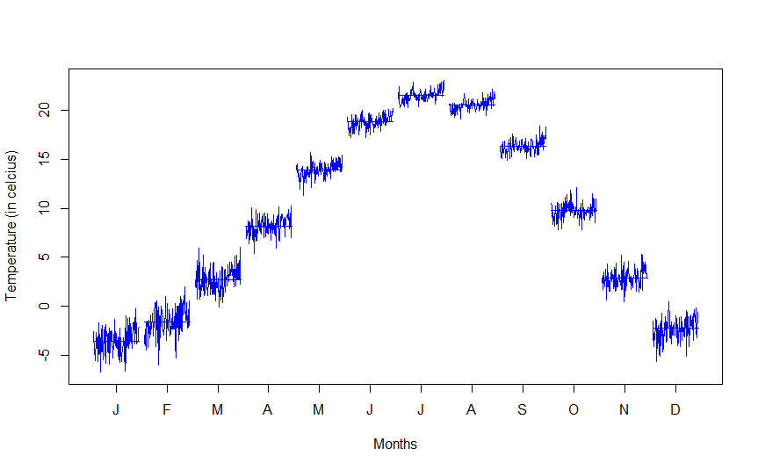
Forecasting:
Seasonality and trend plot for USA temperatures.
Monthly plot for the USA temperatures.

Slide 22
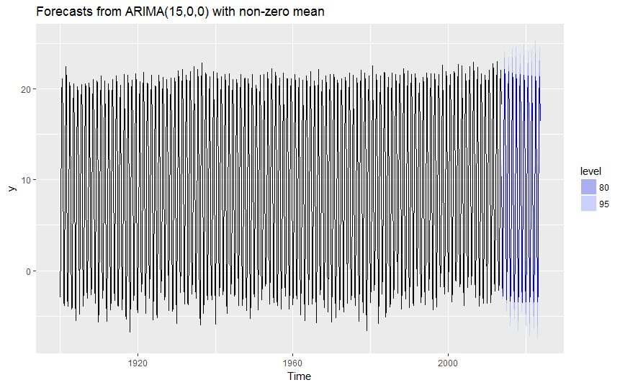
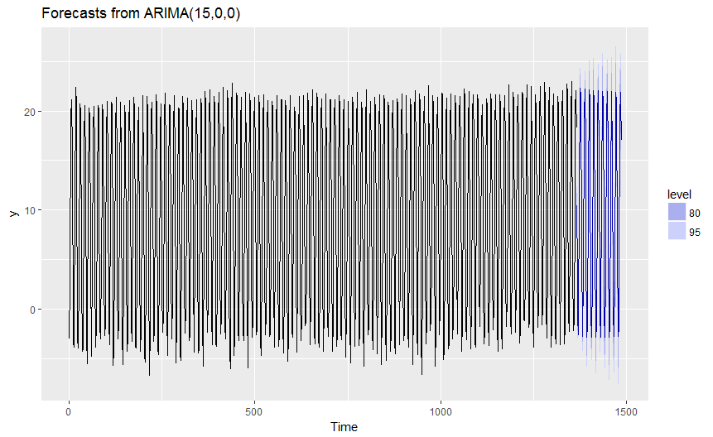
Forecasting:
If we don’t add the seasonality, forecasted values would will lead into wrong results.
When we look at the graphs there is a difference between forecasted values.

Slide 23

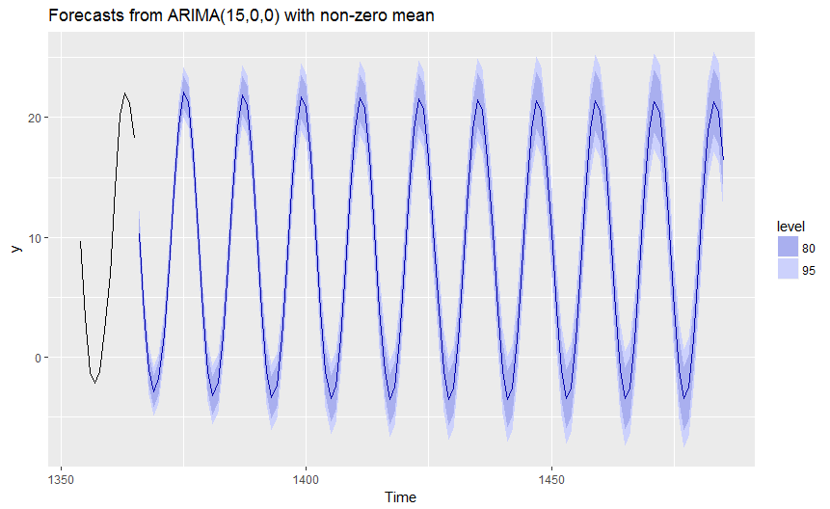
Forecasting:
These graphs represents 120 months forecasting values with historic values.
Second graph represents the same but with zoomed graph for better understanding.

Slide 24
Forecasting:
ssfit <- stl(USATempSub, s.window = 'period')
plot(ssfit, col = '#8B4513')
monthplot(USATempSub$AverageTemperature, xlab = "Months", ylab = "Temperature (in Celsius)", col = 'orange')
fit_diff_ar_1 <- arima(USATempSub$AverageTemperature, order = c(15,0,0), seasonal = c(1,1,1))
fit_diff_arf_1 <- forecast(fit_diff_ar_1, h = 120)
autoplot(fit_diff_arf_1)

Slide 25
Clustering:
Clustering is one of the most commonly used techniques in data mining area.
K - means clustering has been used to compute the clusters in this analysis.
The countries are clustered into 5 groups based on their average temperatures from the year 1900 to the year 2012.
Number of groups is 5, that means K=5.
Algorithm took 3 iterations to complete the process.
The output of k-means has several components i.e. "cluster“, "centers“, "totss“, "withinss“, "tot.withinss“, "betweenss“, "size“, "iter“, "ifault“.
When we plot the world map based on clusters, the map looks as shown in the next slide.

Slide 26
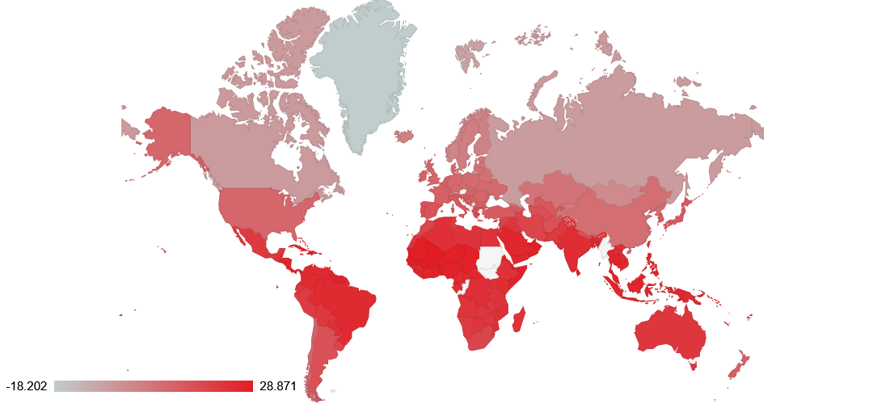
Clustering:
World map based on clusters

Slide 27
Clustering:
Code Snippet:
row.names(global_temp_country_1900_avg) <- global_temp_country_1900_avg[,1]
km <- kmeans(global_temp_country_1900_avg$AvgCountryTemp,5)
Global_temp_country_1900_avg$Cluster <- km$cluster
G4 <- gvisGeoChart(global_temp_country_1900_avg, locationvar = 'Country', colorvar = "AvgCountryTemp",options = list(dataMode = 'regions', width = 1080, height = 500, colors = "['#C1CDCD', '#e31b23']"), chartid = 'EQ')
plot(G4)

Slide 28
Conclusion:
As mentioned in the hypothesis, global warming exists on Earth's surface. This might be converted into severe threat for the future generations. The graphs under Hypothesis tests will support this statement. The graphs represented under the exploratory analysis supports that there is a temperature rise in the USA and all the major cities across the world. With this information, we can confirm that global warming exists across the world due to increase in temperatures year by year. Forecast analysis results are confirming that in future there is more uncertainty in climate temperatures. When we divided countries into groups, few countries in South Asia and few countries in Africa region have the highest temperatures.

Slide 29
Risks, Scope and Assumptions :
The data has been collected from the internet source with an assumption that everything is being correct.
we have not considered the uncertainty while forecasting the future temperatures.
There is more scope to perform in-depth analysis on global temperatures data set. Due to time constraints, we have not focused on in-depth analysis of global temperatures.

Slide 30
Tools:
R Language
R-Studio
Libraries
data.table
dplyr
tidyr
forecast
FactoMineR
Ggplot2
googleVis
ggmap

Slide 31
Q ?
:: Contact ::
apallekonda@my.harrisburgu.edu, VRajappa@my.harrisburgu.edu, AvnSharma@my.harrisburgu.edu

Slide 32
Thank You!

